Slide 1


Azure Infrastructure
Kris Swanson
Partner Technology Strategist

Slide 2




Azure Infrastructure Breadth
Over 100 services, continuous evolution
Data Factory
Traffic manager
Analytics
Event Hubs
SQL Database
SQL Data Warehouse
DocumentDB
Search
ExpressRoute
Machine Learning
HDInsight
Virtual Machines
Cloud Services
Batch
Remote Desktop
Storage
StorSimple
Redis Cache
Virtual network
Azure AD
Multi-Factor
Backup
Site Recovery
Service bus
BizTalk
Management
Automation
Op Insights
DNS
Web Apps
Mobile Apps
Notification Hubs
API Management
Mobile Engagement
App Service
API Apps
Logic Apps
Key Vault
App Gateway
VS Online
VS App Insights
Media Service
Media Intelligence
Media Encoding
Media Protection
Media Player
Media Streaming
CDN
VPN Gateway

Slide 3
Windows Server & Azure
Azure AD
Identity
Backup
Workload Backup
Site Recovery
Business Continuity
Virtual Machines
Extending a Network
Cloud Services
Hosted Web Services
Remote Desktop
Desktop as a Service

Slide 4

IaaS Core Services Overview

Slide 5
Core infrastructure
Compute
Storage
Networking
Management
Virtual machines
Availability sets
VM scale sets
Controlled maintenance
Disks Blob storage File sync
Hot and cold
Virtual networks
VPN, ExpressRoute
Load balancer
DNS, Traffic Manager
Log Analytics
Cloud Shell
Site Recovery
Security Center

Slide 6
Core Services of Azure IaaS
Compute
Storage
Networking
Security & Management
Virtual machines
Availability sets
VM scale sets
Disks Blob storage Files
Virtual networks
VPN, ExpressRoute
Load Balancer
DNS, Traffic Manager
Log analytics
Backup
Site Recovery
Security Center

Slide 7
Compute (Virtual Machines)

Slide 8
Virtual Machines & Scale Sets
Compute
Storage
Networking
Management
Minimal learning curve for existing virtualization pros
Run most Windows or Linux-based workloads
Easiest target for migrating to the cloud
Flexible instance sizes – use the best fit for your workload
Advanced networking and storage capabilities
Virtual Machines
All of the power and flexibility of a Virtual Machine
Designed for high-end workloads
Automatically scale up (or down) to 1000 instances
Virtual Machine Scale Sets

Slide 9



Compute options for all types of apps
Compute
Storage
Networking
Management
A
Av2
B
D
Dv2
Dv3
F
Fv2
ENTRY LEVEL
BURSTABLE
GENERAL PURPOSE
COMPUTE OPTIMIZED
G
Ev3
M
L
NC
NV
NCv2
ND
H
MEMORY OPTIMIZED
STORAGE OPTIMIZED
GRAPHICS INTENSIVE
HIGH PERFORMANCE COMPUTING
HANA
PURPOSE-BUILT FOR
SAP HANA

Slide 10
Availability Options
Compute
Storage
Networking
Management
VM SLA
99.9% with Premium Storage
VM SLA
VM SLA
MULTI-REGION DISASTER RECOVERY
99.95%
99.99%
Region 1
Region 2
SINGLE VM
AVAILABILITY SETS
AVAILABILITY ZONES
REGION PAIRS
Easier lift and shift
Protecting against failures within datacenters
Protection from entire datacenter failures
Regional protection within Data Residency Boundaries

Slide 11
Most comprehensive resiliency and best SLA
INDUSTRY-ONLY
INDUSTRY-LEADING HIGH AVAILABILITY SLA
INDUSTRY-LEADING DISASTER RECOVERY
VM SLA
VM SLA
VM SLA
REGIONS 54
99.9%
99.95%
99.99%
Region 1
Region 2
SINGLE VM
AVAILABILITY SETS
AVAILABILITY ZONES
REGION PAIRS
Protection with Premium Storage
Protection against failures within datacenters
Protection from entire datacenter failures
Protection from disaster with Data Residency compliance

Slide 12
Design for Scale
Excess Capacity
Insufficient Capacity
Week 1
Week 2
Week 3
Week 4
Week 5

Slide 13
Scale Up vs. Scale Out

Slide 14
Scale vs. Time
Week 1
Week 2
Week 3
Week 4
Week 5

Slide 15
Storage

Slide 16
Azure Storage
Compute
Storage
Networking
Management
IaaS
Virtual machines
Storage
Networking
Disks
Persistent disks for Azure IaaS VMs
Premium Storage Disks option: SSD based, high IOPS, low latency
Files
Fully Managed File Shares in the Cloud
SMB and REST access
“Lift and shift” legacy apps
Synch with on-premises (New!)
Blobs
Highly scalable, REST based cloud object store
Block Blobs: Sequential file I/O
Cool Tier Available
Page Blobs: Random-write pattern data
Append Blobs
Tables
Massive auto-scaling NoSQL store
Dynamic scaling based on load
Scale to PBs of table data
Fast key/value lookups
Queues
Reliable queues at scale for cloud services
Decouple and scale components
Message visibility timeout and update message to protect against unreliable dequeuers
Built on a unified Distributed Storage System
Durability, Encryption at Rest, Strongly Consistent Replication, Fault Tolerance, Auto Load-Balancing

Slide 17


VM Storage Basics
Compute
Storage
Networking
Management
3 Copies Locally Redundant per disk
Asynchronous GEO-Replication
(Standard Storage)
Microsoft Azure Storage
Microsoft Azure Storage
Storage I/O
C: Drive
VM
West US
East US

Slide 18

Virtual Machine Storage Basics
Compute
Storage
Networking
Management
Premium disks
SSD based, high IOPS, low latency
Up to 64 TB, 80000 IOPs
Appropriate for data base, file servers, and interactive applications that have a dependency on high IOPs and low latency storage.
Standard disks
Magnetic disks, HDD based. Up to 500 IOPs/disk
Appropriate for web and application servers that do not have a dependency on high IOPs or low latency storage.
Files
“SMB File Share”
SMB 3.0
Shared storage (read/write multiple virtual machines), replace file servers, support legacy applications and support lift and shift style workloads

Slide 19
Networking

Slide 20


Azure Networking
Compute
Storage
Networking
Management
Virtual network
Private IP addresses, Network-level isolation
Segment with subnets and security groups
Control traffic flow with user-defined routes
Internet access
Azure virtual network
ExpressRoute
VPN gateways
Hybrid connectivity
Point-to-site for dev/test
VPN gateways for secure site-to-site connectivity
ExpressRoute for private enterprise grade connectivity
Domain-join with on-premises

Slide 21
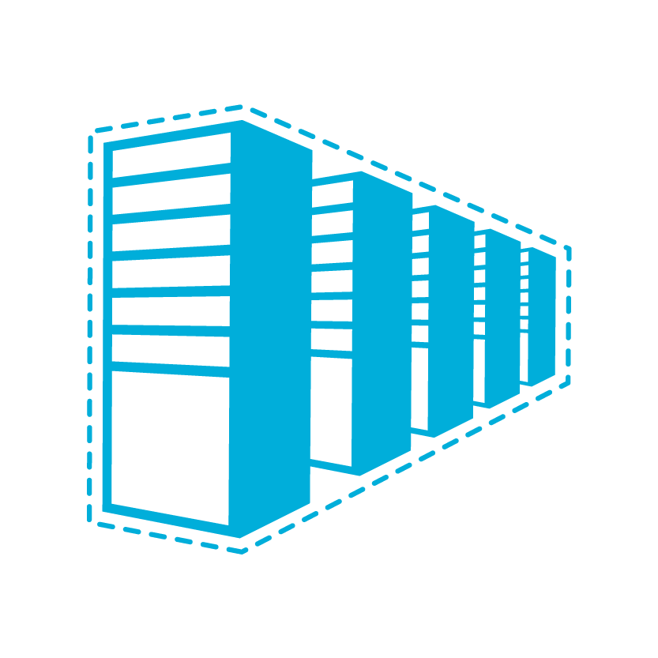


Connectivity Options to Azure
Compute
Storage
Networking
Management
Secure point-to-site connectivity
POC Efforts
Small scale deployments
Connect from anywhere
Connect to Azure compute from on-premises or another Azure region
Secure site-to-site
VPN connectivity
In-region VNet-to-VNet connectivity
Direct VM-to-VM connectivity
Peer VNets for routing and transit
VNet Peering
within region
Private connectivity from your on-premises data center to Azure virtual networks and PaaS Services
ExpressRoute private connectivity

Slide 22




Load Balancing
Compute
Storage
Networking
Management
Load Balancer
Application Gateway with WAF
Traffic Manager
3rd Party Solutions from Marketplace

Slide 23
Management & Security

Slide 24
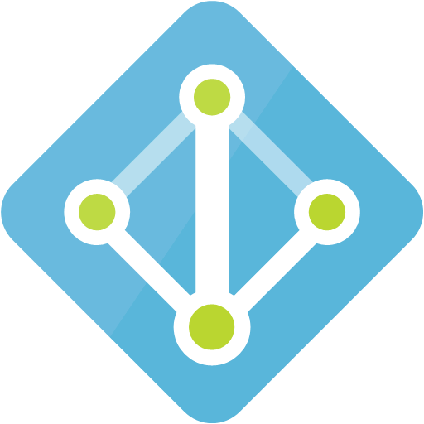

Azure Active Directory
Compute
Storage
Networking
Management
Azure Resources
Authentication
& Authorization
Users
Groups
Subscription
Resource
Groups
Resources
Service Principals
Azure Active Directory
Azure Subscription

Slide 25
Azure Resource Manager (ARM)
Compute
Storage
Networking
Management
Enable application management within Azure
Resource groups are containers that can contain multiple IaaS + PaaS resources
Templatize application deployment and configuration, supports DevOps
Governance and control with Role Based Access Control (RBAC), policies and resource locks
RESOU
R
CE G
R
OUP

Slide 26
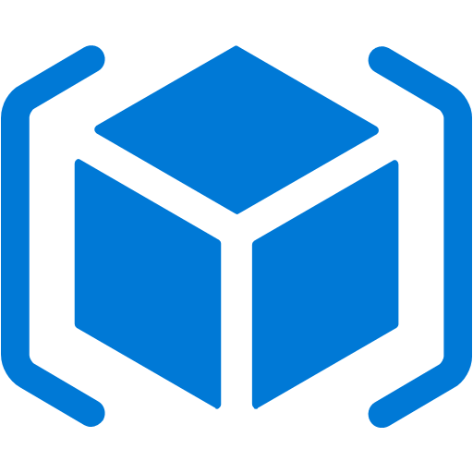






Management & Security
Compute
Storage
Networking
Management
Azure Active Directory
Cloud based directory and identity management
Azure Resource Manager
Organize, deploy and control resources in Azure
Azure Security Center
Prevent, detect, and respond to threats with increased visibility
Azure Advisor
Optimize across four different areas: high availability, performance, security, and cost
Azure Log Analytics
Collect, search, and visualize machine data from on-premises and cloud
Azure Key Vault
Protect secrets such as passwords and keys securely
Azure Backup
Protect your virtual machines, data, or enterprise workloads by securely backing it up to Azure
Azure Site Recovery
Orchestrated failovers/back to Azure, Azure to Azure or data center to data center – great for migration!

Slide 27
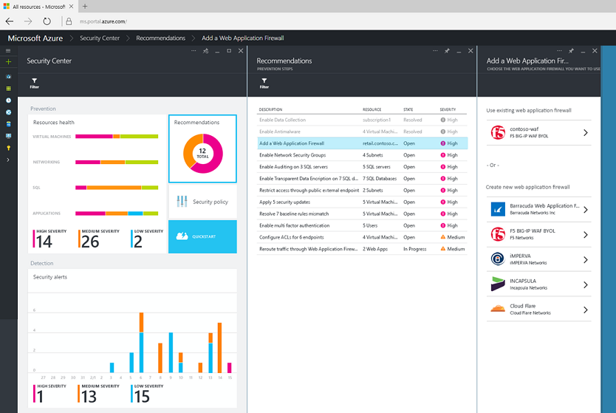
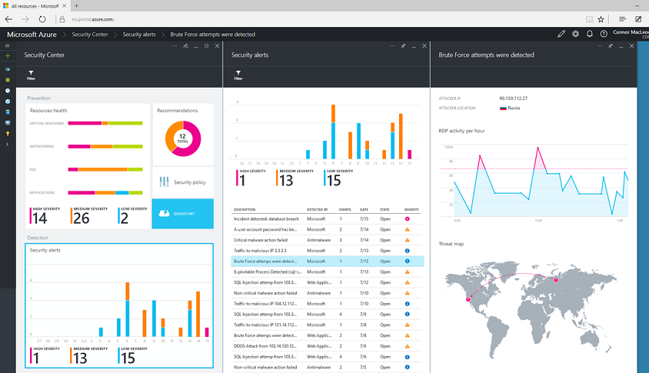
Azure Security Center
Understand your cloud security state
Define security policies for your Azure subscriptions and to help guide resource owners correctly implement required controls
Easily deploy integrated cloud security solutions from Microsoft and trusted security partners
Detect threats and respond fast by combining Microsoft global threat intelligence and expertise, with insights into cloud security-related events across your Azure deployments, Security Center helps you detect actual threats early and reduce false positives.

Slide 28
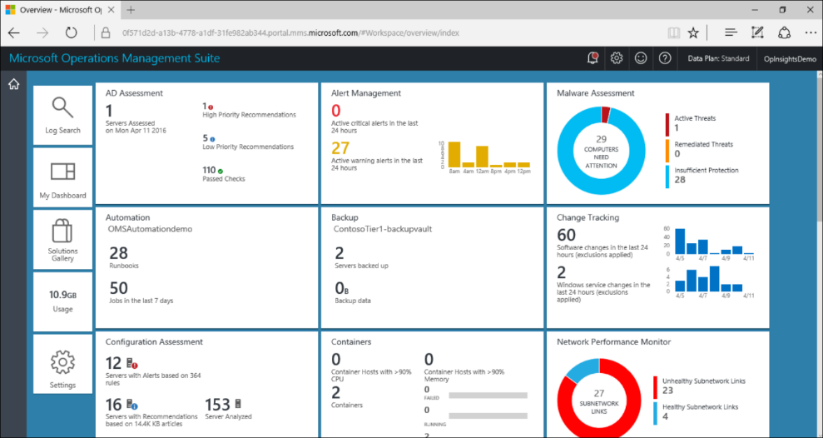
Azure Log Analytics
Insights & Analytics
Gain visibility across your hybrid cloud
Deliver insights across your datacenters and public clouds, including Azure and AWS.
Easy collection, correlation, and visualization of your machine data
Insight into physical, virtual, and cloud infrastructure health, capacity, and usage
Collect, store, and analyze log data from virtually any Windows Server and Linux source.

Slide 29
Tools
Tools
Developer tools
Developer tools
DevOps
DevOps
Management tools
Management tools
Advanced workloads
Advanced workloads
Web
Mobile
Microservices
Containers
Integration services
Web
Mobile
Microservices
Containers
Integration services
Media
Analytics
Databases
Internet of Things
AI + Machine Learning
Media
Analytics
Databases
Internet of Things
AI + Machine Learning
Trusted
Azure Stack + Hybrid
Productive
Intelligent
Hybrid
Core infrastructure
Compute
Networking
Storage
Security
Identity

Slide 30
Application development
Tools
Advanced workloads
Core infrastructure
Azure Stack + Hybrid
Azure Container Service (AKS)
Service fabric
App service
Logic apps + Functions
Managed Kubernetes, automated upgrades
Build, deploy and operate applications at scale
Web, mobile and API apps
Event–driven, serverless computing

Slide 31
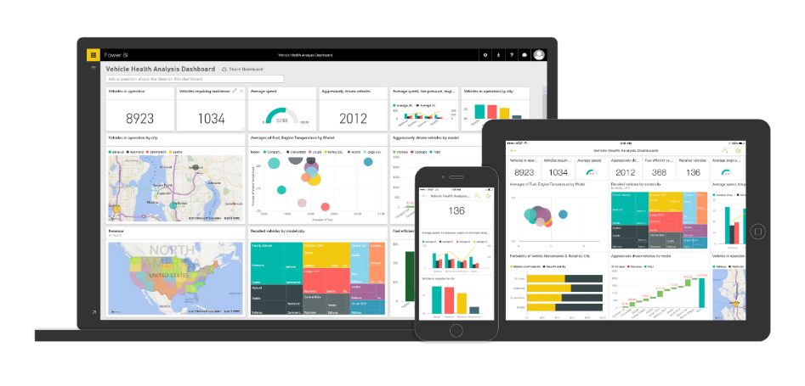
Business insights
Tools
Advanced workloads
Core infrastructure
Azure Stack + Hybrid
Back–end power
Front–end insights
Big data
Web data
Traditional data

Slide 32
Machine learning
Tools
Advanced workloads
Core infrastructure
Azure Stack + Hybrid
Azure machine learning templates
Azure machine learning services
Data
Modeling & APIs
Clients
Demand forecasting
Predictive maintenance
Vehicle telemetry
Cloud
ML workbench
Big data
Web data
API
Traditional data

Slide 33
Internet of things
Tools
Advanced workloads
Core infrastructure
Azure Stack + Hybrid
Azure IoT suite
Street sweepers
Buses
Cows
Vending machines
Buildings
Device connectivity and management
Postboxes
Data ingestion, command and control
Auto
Oil equipment
Aircraft
Factory floor
Stream processing and predictive analytics
Electric charging stations
Power plant
Workflow automation and integration
IoT
Racing
Dogs
Dashboards and visualization
Medical devices
Trucks
Preconfigured solutions
Power tools
Mining equipment
Oil distribution
Elevators
Remote monitoring
Smart grids
Predictive maintenance
Smart meters
Surveillance
Engines
Connected factory (new)

Slide 34
High performance computing
Tools
Advanced workloads
Core infrastructure
Azure Stack + Hybrid
Most performant infrastructure
Low latency networking with RDMA and Infiniband
Risk simulations
Fluid dynamics
Graphics and rendering
Open and integrated
From CentOS and Ubuntu to enterprise support like SuSe and Redhat
Deep learning
Crash simulations
HPC
Granular cost control and governance
Flexible consumption and cost savings with low–priority VMs on Azure
Molecular modelling
Structural
simulations
Genomics

Slide 35
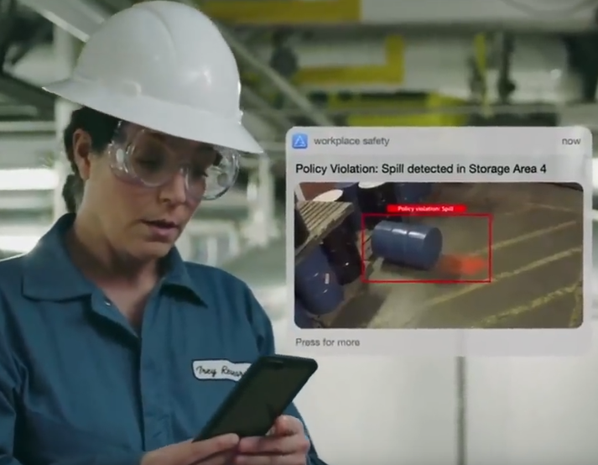



Cognitive services
Tools
Advanced workloads
Core infrastructure
Azure Stack + Hybrid
Vision
From faces to feelings, allow apps to understand images and video
Show me what is in the image
Speech
Hear and speak to users by filtering noise, identifying speakers and understanding intent
Convert this text to speech please…
Language
Process text and learn how to recognize what users want
Play today’s conference call…
Knowledge
Tap into rich knowledge amassed from the web, academia or your own data
Top publications in AI...
Search
Locate relevant information among billions of web pages, images, videos and news with Bing APIs
Fraud prevention results…

Slide 36

Your vision. Your cloud.

